Slide 1
BYGB 7988 Business Performance Management Risk Analytics
Section 2
Case 1
Instructor: Dr. W “RP” Raghupathi
Prepared By: Regan Alt

Slide 2
Question 1. What challenges does Thomas Schmall face upon becoming CEO of Volkswagen do Brasil (VMB)? Briefly discuss.
Challenges Schmall faced when becoming CEO of VMB in 2007:
VMB was going through a restructuring plan due to previous 7 years of consecutive losses
The 2 key consumer indicators ‘Things gone wrong’ (TGW) and “Customer Satisfaction Index” (CSI) were behind management objectives
Macroeconomic situation in Brazil:
Brazilian currency had appreciated against the dollar and euro
Increased costs in labor and raw materials made Brazilian automobiles unattractive in the export market
Global automotive competitiveness prevented VWB from raising prices to cover excess capacity costs
The economically difficult years made a bureaucratic and conservative VWB culture and atmosphere due to the fear of instability among the workers
Schmall did not want to repeat history using cost reduction, employee layoffs and capacity downsizing

Slide 3
(Q1) How analytics can help mitigate some of the challenges:
Schmall wanted to build a high performance team that would make VWB the industry leader in quality, innovation, sales, and profitability in South America
Analytics could be used to define new Key Performance Indicators at micro level to mitigate some of the challenges
By improving productivity, Schmall could eliminate customer dissatisfaction, improve inefficiency and maximize employee value by optimizing each phase of production process
KPI Strategy:
Customer indicators: Use customer analytics to respond to consumer demands, achieve target market share, grow sales per customer, improve loyalty index
Personnel Indicators: Measure employee analytics, so they feel more accountable to meet the performance indicators and progress further past them. Improve employee benefits such as healthcare.
Process Indicators: Accelerate turnover rate using product and customer analytics by reducing lead time in response to market demands
Financial Indicators: minimize costs, gain majority of Brazilian market share to bolster economy and providing for domestic and international consumers

Slide 4
Question 2. Describe VWB’s new strategy.
New strategy consists of reeducating the VWB management team to spend money wisely in order to expand market share, improve processes and innovate new products
Also, revamp relationships with key stakeholders (employees, suppliers, dealers) by shifting the mindset of the company down to the factory floor
Schmall wanted to implement a Strategy Map based on: Finance, Customer, Internal Process, and Potential and Growth
The VWB Executive Committee translated each strategy map’s objectives into specific indicators and assigned an executive to each goal
Each executive had to monitor and achieve the performance targets for each of the objectives metrics, by relaying the initiatives to employees and driving performance

Slide 5
(Q2) How does business performance management help execute this strategy? What support may analytics provide?
Using predictive analytics and business performance measurements to execute this strategy:
Using Predictive analytics:
Helps Schall determine what would happen regarding specific scenarios unfolding, i.e meeting revenue numbers or expanding market share
Can be used to adjust product offerings and pricing in real time by gauging consumption patterns to predict which vehicles will sell in certain markets at certain times
Implementing Business Performance Management:
To manage budgeting and better understand other capital investments such as building a new factory
To look at data by region within Brazil so it can react to fluctuations in the market more quickly
To create R-squared models for developing capital-asset pricing models to enhance marketing campaigns
To streamline business processes, enhance shareholder value, and create a more flexible organizational structure that can adapt to market changes more dynamically

Slide 6
Question 3. How does the strategy map (Exhibit 4) and Balanced Scorecard (Exhibit 5) help Schmall and Senn implement the new strategy?
Strategy Map (Exhibit 4):
The Strategy map facilitates the translation of Schmall and Senn’s new strategy for VWB by identifying the challenges the organization faces (financial, customer, internal processes, potential and growth)
It breaks down the objectives that will be used to overcome these challenges in each category
Ultimate goal is to achieve sustainable and positive financial results
Balanced Scorecard (Exhibit 5):
The Balanced Scorecard helps by addressing the metrics needed to be met for the VP of each team, who then transfers the objectives to employees more effectively
Each department can use the overarching strategy and apply it to their particular group
Can tie targets to individual performance and compensation system to incentivize employees and understand how their own productivity supports the overall strategy

Slide 7
(Q3) What are the strengths and weaknesses of the scorecard and its implementation?
How does a scorecard relate to analytics? [2 slides].
Strengths & Weaknesses:
Strengths:
The scorecard addresses serious deficiencies and thus can act as a link to VWB’s long-term strategic objectives through short-term micro-level actions
Ex: mitigates dependency on financial indicators to measure company performance, allowing managers to focus on Customer Satisfaction Index instead
Weaknesses
The scorecard may only be implemented effectively if all VP’s and teams collaborate and stay on track
May also require a lot of investment in time and money if the strategy calls for new technology or employees to be retrained
How the Scorecard Relates to Analytics:
The scorecard provides the framework for VP’s to integrate customer, product, operational and financial analytics to achieve VWB’s overarching objectives

Slide 8
Question 4. How can Schmall and his team use the scorecard to deal with the challenges faced by the company in January 2009?
Challenges in 2009:
Excess capacity due to unsold production from the fourth quarter was troublesome
The 2009 Brazilian economy was unstable and riddled with uncertainty due to the global financial crisis which threatened to reduce global economic growth and trade
Implementing the Scorecard:
To determine whether there was enough demand and potential revenues to resume higher production levels
The VP of Supply, Operations, Product Development and Sales and Marketing would have to collaborate to see where they could cut discretionary spending to meet each topline goal
Due to the downturn of global economic trade, they could continue expanding market share domestically, and maintaining a production volume strategy that adapts to industry volatility

Slide 9
(Q4) What other types of analytics may the team consider? Give examples of metrics ← → analytics.
Metrics to Consider:
Using management dashboards to bring together information such as timing of product releases (through graphs and charts) which portray performance insights to employees at every level
Create KPI’s to develop a competitive advantage in the automotive industry, increase Return on Investment, and improve Customer Satisfaction Index
Parsing the internet for insights in demand levels and success of marketing campaigns using big data, web and text analytics
Reward and recognition systems could be used to drive performance and motivate employees, leading to a greater Employee Image Index and Efficiency Indicators
Utilize Business intelligence (BI) tools to derive what factors truly drive performance and be able to predict future Net Cash Flows

Slide 10
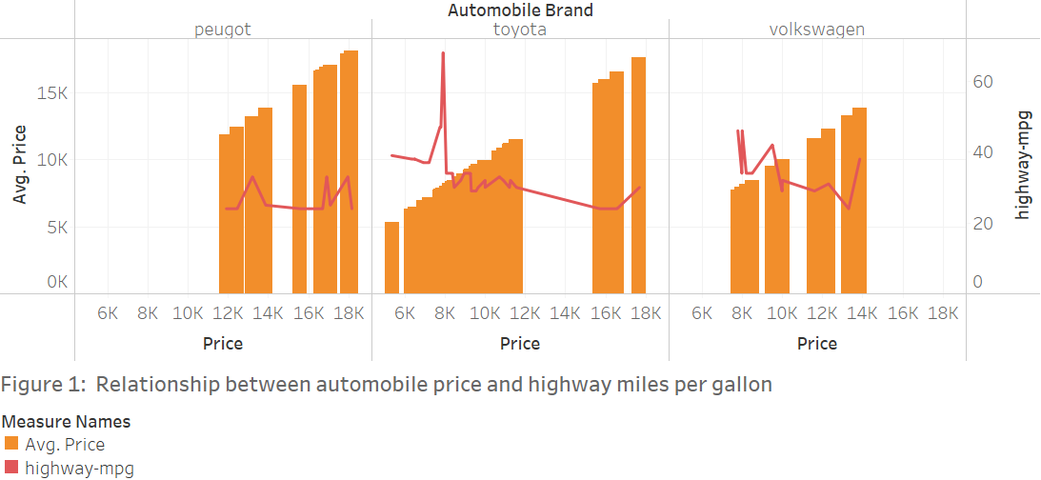
Insight 1: Volkswagen’s higher-end vehicles have more miles per gallon compared to competitors
Question 5. Develop 3 insight charts for Volkswagen/car industry relating to performance.
The chart shows the variability between average price per vehicle and how many miles on the highway the car lasts per gallon.
The insights derived from this chart indicate Volkswagen’s most expensive vehicles can last more miles per gallon (mpg) than its competitors at the same price level.
Since Volkswagen consumers get more mpg on the highway at a lower price, Volkswagen marketers should emphasis this competitive advantage to gain more market share. They could also price these vehicles higher to increase revenues, since competitors offer much higher prices for much fewer mpg.

Slide 11
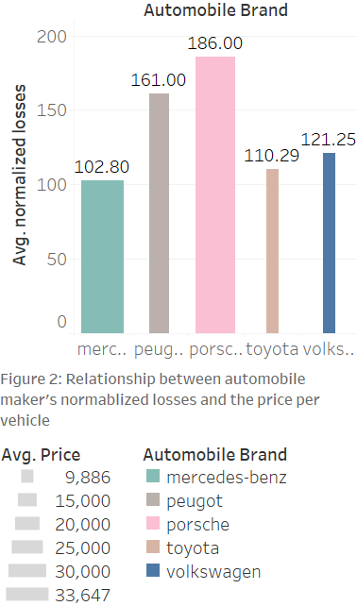
Insight 2: There is a positive correlation between a automobile’s price and their average normalized losses
(Q5)
This chart shows the positive correlation between relative average loss payment per insured vehicle per year and the price per vehicle, for each automobile maker.
The price per vehicle is represented by the width of the bar, and thus it is evident the three most expensive automakers render greater normalized losses on average than the less expensive vehicles.
Volkswagen appears to have only slightly more normalized losses than Mercedes-Benz, but at much lower prices. They could use this insight to highlight to consumers their vehicles are cost slightly more to fix damages, but are almost half the price than those of leading competitors.

Slide 12
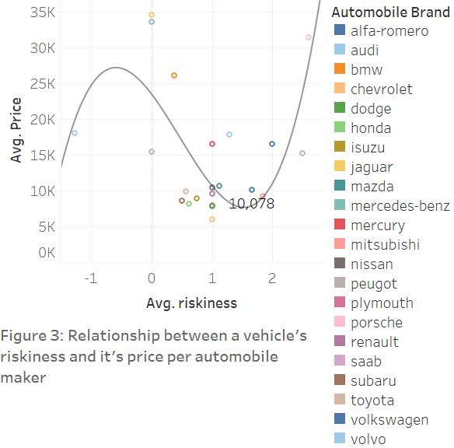
Insight 3: A vehicle’s level of riskiness is associated with average price per automaker
(Q5)
This chart shows the average riskiness, where 3 is the riskiest, associated with the vehicles average price for each automobile maker in the dataset.
The insights derived from this polynomial trendline with an R-squared of .490 and P-value of 0.0060 suggest level of a car’s risk can factor into price.
Volkswagen, highlighted by its average price per vehicle has a slightly higher risk factor than a majority of the other carmakers. They could invest in research and development to offer a safer car at a higher price, such as honda or jaguar.

Slide 13
(Q5) Interpret the results. Provide insight to make informed decisions at Volkswagen
Based on this analysis, it is recommended that moving forward Volkswagen highlights their competitive advantage of offering lower prices on average per vehicle with higher miles per gallon on the highway compared to competitors.
Additionally, Volkswagen has the opportunity to emphasize their unique selling point that their vehicles garner fewer normalized losses on average for the price of the vehicle, compared to higher-end brands such as Peugeot and Porsche. This could improve both company image and Consumer Satisfaction Index if they consider the cost per vehicle outweighs the potential loss in damages if they were to get into an accident.
Overall, Volkswagen offers good quality vehicles at a lower price than high-end retailers. Depending on the consumers preference for miles per gallon, riskiness, and repair costs relative to vehicle price, Volkswagen has the potential to expand to almost every market around the world.
Automobile data source: https://data.world/uci/automobile

